Slide 1
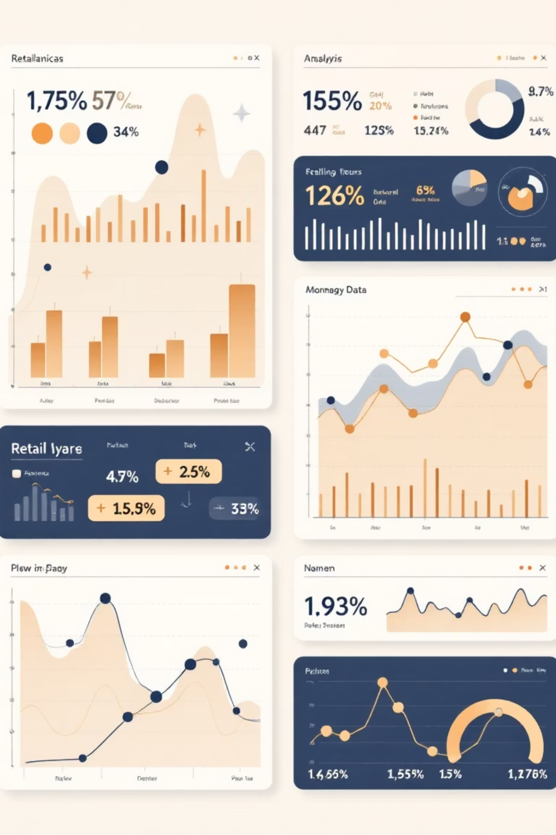
Customer Shopping Behavior Analysis
Transforming raw data into actionable business insights using Python, SQL, and Power BI

Slide 2

CHALLENGE
The Business Problem
Sales Performance
Customer Targeting
Need insights to improve revenue and conversion rates
Identify high-value segments for marketing
Inventory Management
Optimize stock based on purchase patterns

Slide 3
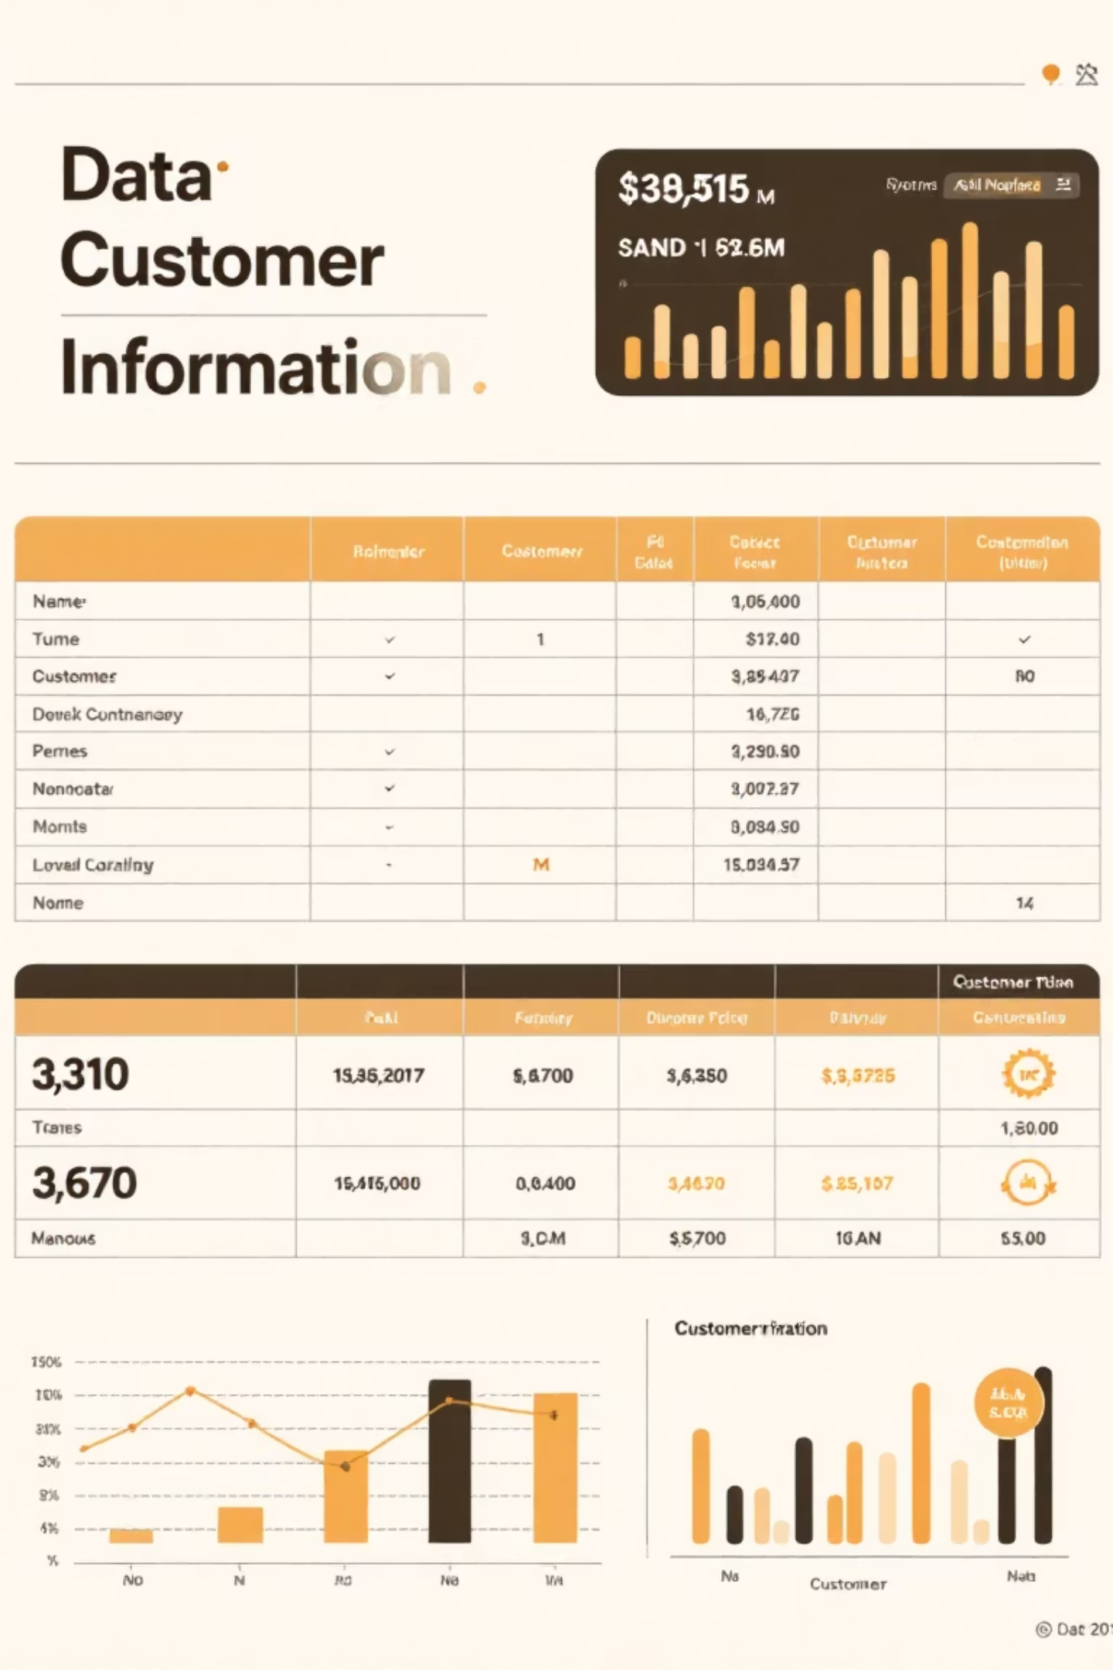
DATASET
Data Foundation
Key Data Points
8
Customer demographics (Age, Gender)
Core Columns
Purchase details (Category, Item, Amount)
Essential data fields analyzed
Transaction info (Payment Method, Location)
Customer behavior patterns

Slide 4

TECHNOLOGY STACK
Tools & Technologies
Python
SQL
Power BI
Pandas, NumPy, Matplotlib, Seaborn for data processing and visualization
PostgreSQL for structured queries and data analysis
Interactive dashboards and business intelligence reporting

Slide 5
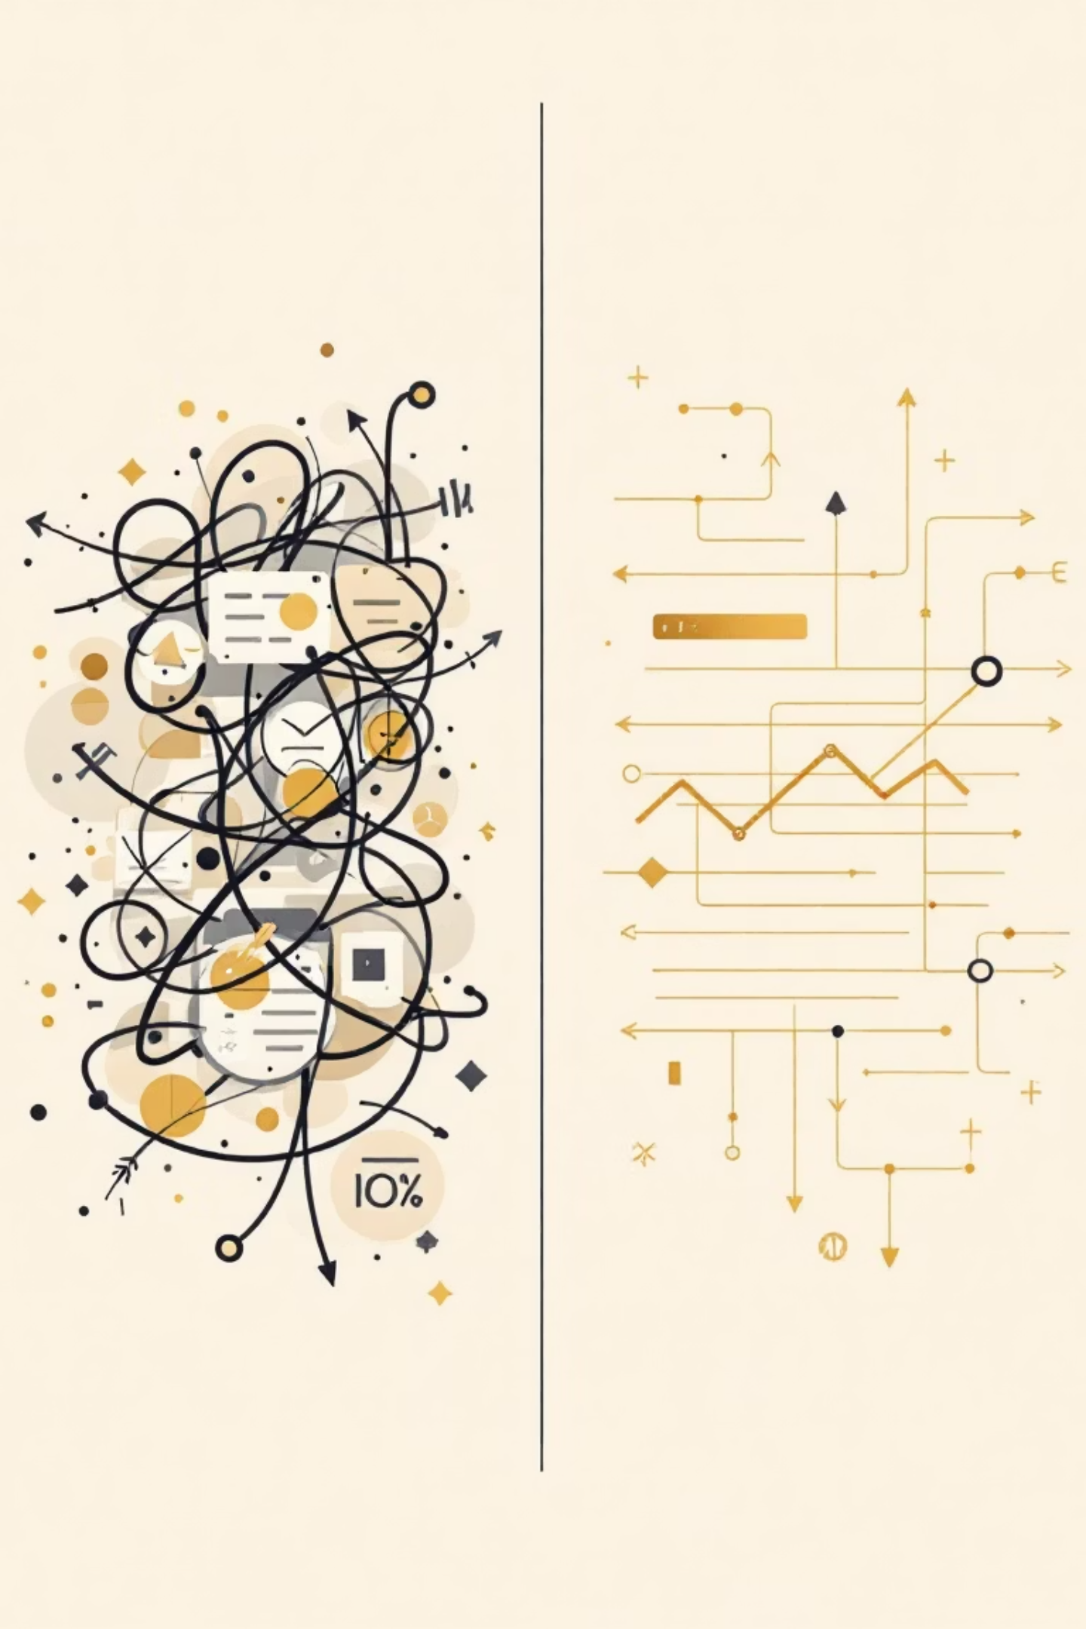
PROCESS
Data Preprocessing
01
Remove Null Values
Cleaned dataset by eliminating missing data points
02
Standardize Columns
Unified naming conventions for consistency
03
Feature Engineering
Created age_group and purchase_frequency_days columns
04
Database Integration
Connected to PostgreSQL for SQL analysis

Slide 6

ANALYSIS
SQL Insights: Revenue & Spending
1
2
Revenue by Gender
High-Spending Discount Users
Compared total revenue: Male vs Female customers
Customers using discounts but spending above average
3
4
Top 5 Products by Rating
Shipping Analysis
Identified highest-rated items across categories
Standard vs Express: average purchase comparison

Slide 7
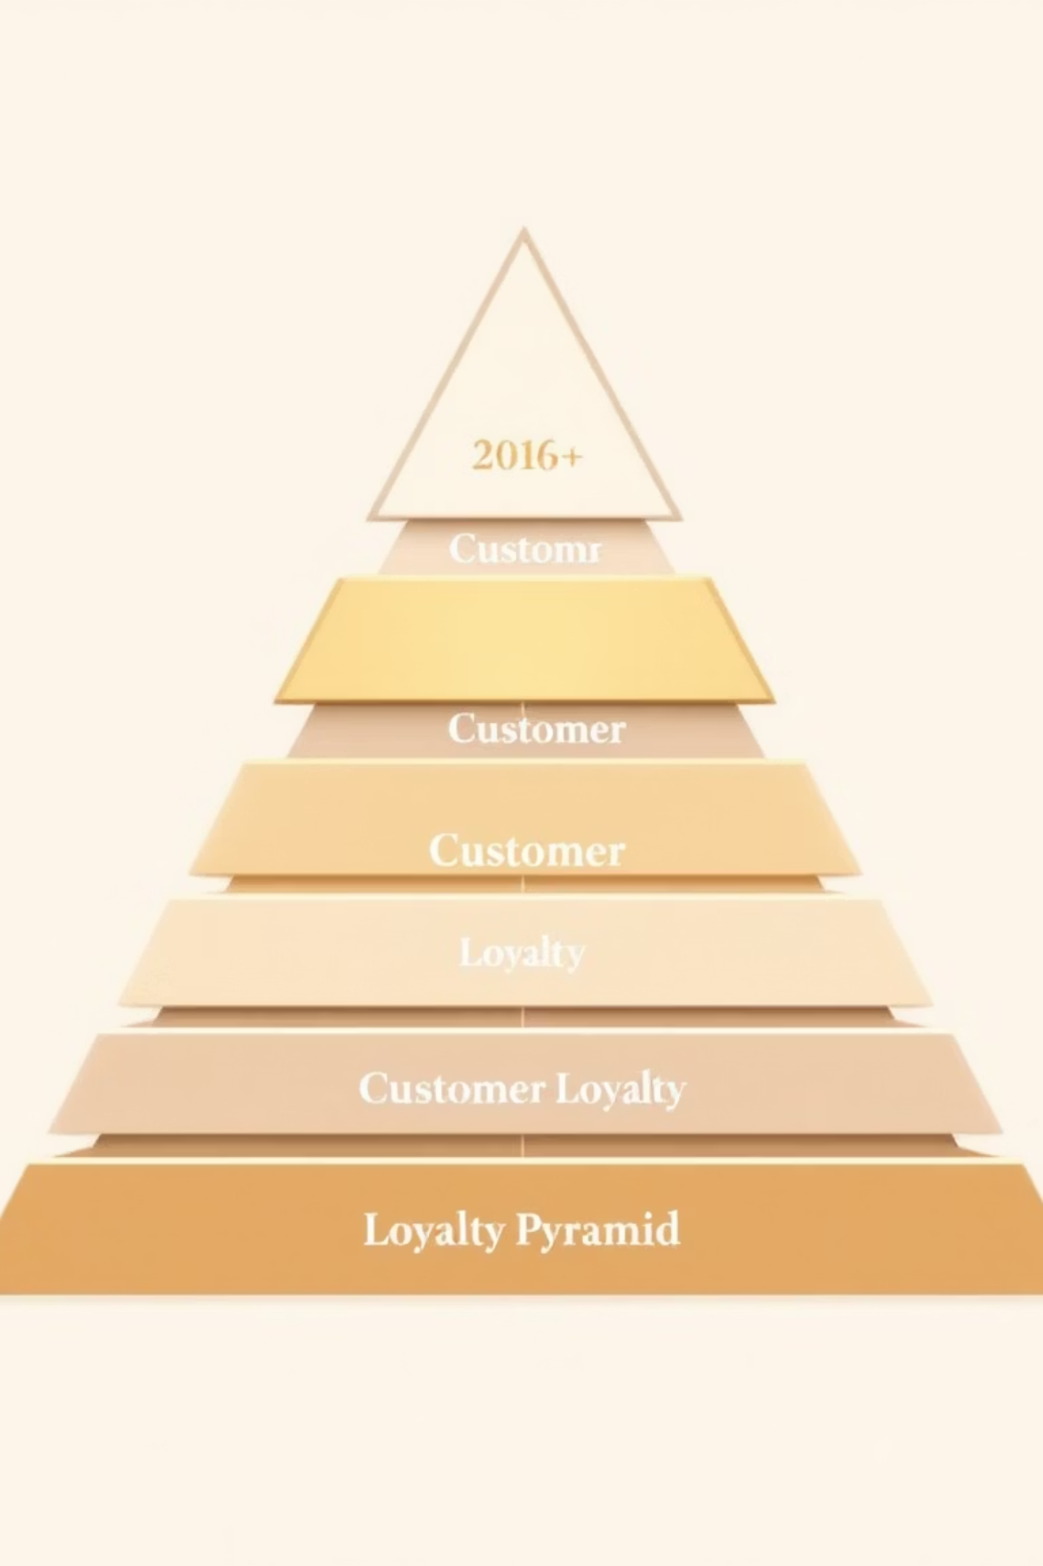

Customer Segmentation Results
Key Finding
Repeat buyers with >5 purchases show significantly higher subscription rates
New Customers
First-time buyers
Subscribers generate higher average revenue and purchase frequency
Returning
2-5 purchases
Loyal
5+ purchases

Slide 8

DASHBOARD
Power BI Interactive Dashboard
Real-time visualization of customer behavior patterns and business metrics
Revenue by Age Group
Category-wise Sales Performance
Gender Distribution Analysis
Payment Method Preferences

Slide 9





KEY INSIGHTS
Business Discoveries
Middle-Aged Revenue
Highest contribution from 35-50 age group
Top Categories
Clothing & accessories lead sales
Payment Trends
Digital methods most preferred
Gender Patterns
Distinct behavior by gender
Data-driven insights enable improved customer segmentation, better inventory planning, and enhanced marketing strategies

Slide 10

NEXT STEPS
Future Scope & Impact
Completed Achievements
Future Enhancements
Predictive modeling for spending
End-to-end analytics workflow
ML-based customer clustering
Improved customer segmentation
Advanced KPIs development
Data-driven decision support
Real-time dashboard integration
Interactive visualization dashboards

